Slide 1
ALGORITHM
Manisha Koranga
Assistant Professor
CSE Department
Graphic Era Hill University, Haldwani

Slide 2
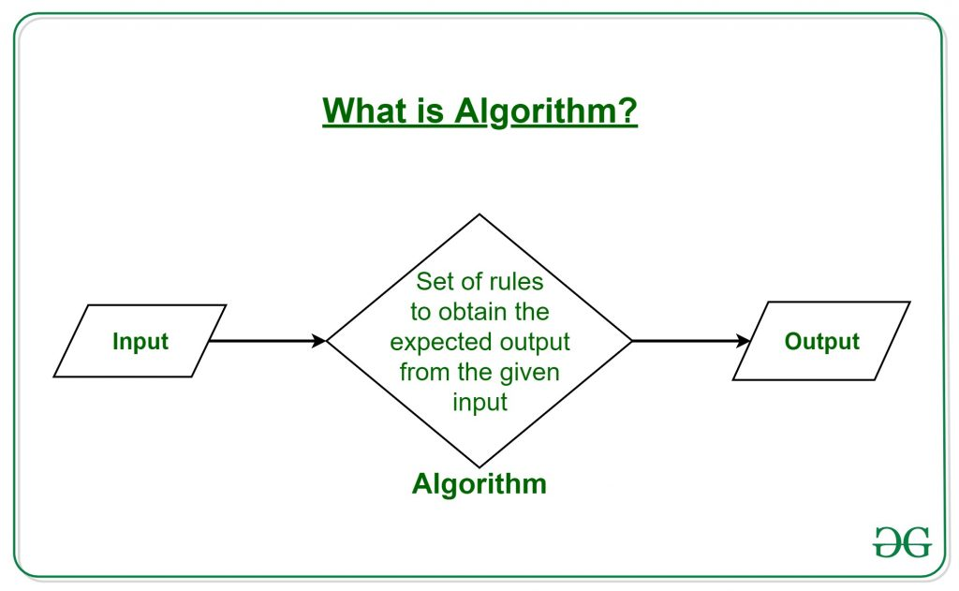
Course Outline
Good Computer Program
What is Algorithm?
Algorithm Properties/ characteristics
How to Write Algorithm Example?
Data Structure Point of View..
Algorithm Analysis
Algorithm Complexities

Slide 3
Good Computer Program
A Computer program is a series of instructions to carry out a particular task written in a language that a computer can understand.
The process of preparing and feeding the instructions into the computer for execution is referred as programming.
There are a number of features for a good program
Run efficiently and correctly
Have a user friendly interface
Be easy to read and understand
Easy to debug, modify and maintain.

Slide 4
What Is Algorithm? Program=Algorithm + Data Structure
An Algorithm is a method of representing the step-by-step procedure for solving a problem.
It is a method of finding the right answer to a problem or to a different problem by breaking the problem into simple cases.
Every single procedure that a computer performs is an algorithm
It is a precise procedure for solving a problem in finite number of steps.
An algorithm is a well ordered collection of clear and simple instructions of definite and effectively computable operations that when executed produces a result and stops executing at some point in finite amount of time rather than just going on and on infinitely.

Slide 5
Algorithm Properties/ Characteristics
It must possess the following properties:
Finiteness: An algorithm should terminate in a finite number of steps.
Definiteness: Each step of the algorithm must be precisely (clearly) stated.
Effectiveness: Each step must be effective. i.e.; it should be easily convertible into program statement and can be performed exactly in a finite amount of time.
Generality: Algorithm should be complete in itself, so that it can be used to solve all problems of given type for any input data.
Input/output: Each algorithm must take zero, one or more quantities as input data and gives one of more output values.

Slide 6
How To Write Algorithm Example?
An algorithm can be written in English like sentences or in any standard representations. The algorithm written in English language is called Pseudo code.
Example: To find the average of 3 numbers, the algorithm is as shown below.
Step1: Read the numbers a, b, c, and d.
Step2: Compute the sum of a, b, and c.
Step3: Divide the sum by 3.
Step4: Store the result in variable of d.
Step5: End the program.

Slide 7
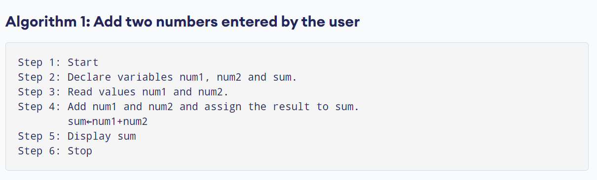
Example 2

Slide 8
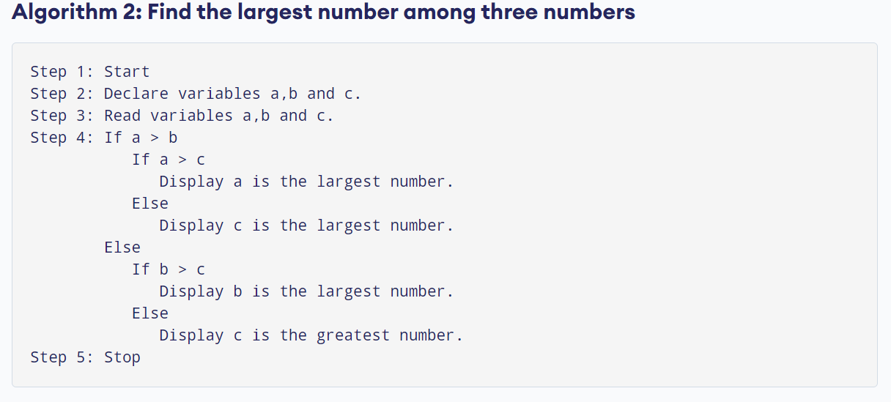
Example 3

Slide 9
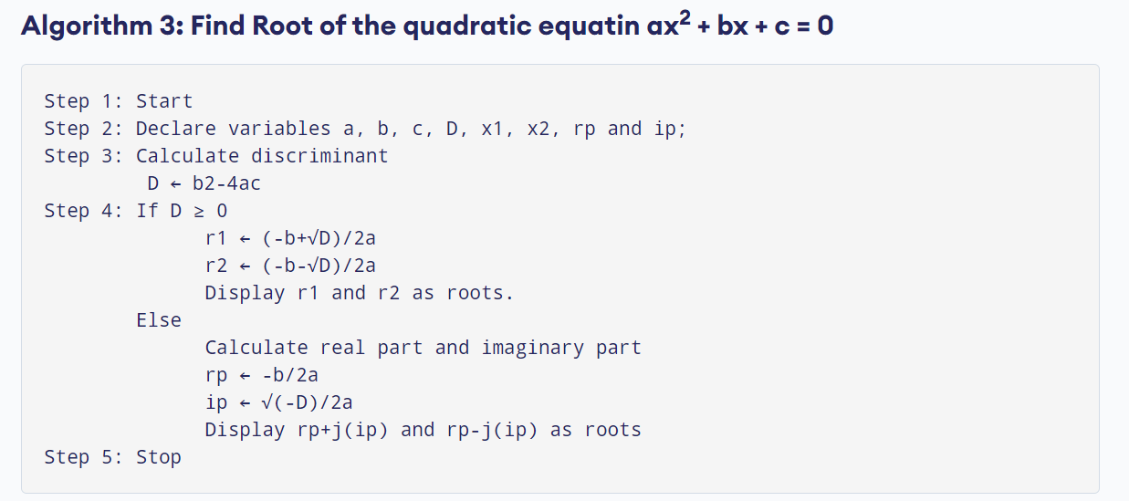
Example 4

Slide 10
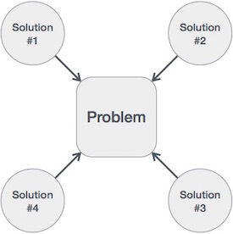
Data Structure Point Of View..
Search- Algorithm to search an item in a data structure.
Sort- Algorithm to sort items in a certain order.
Insert- Algorithm to insert an item in a data structure.
Update- algorithm to update an existing item in a data structure.
Delete- Algorithm to delete an existing item from a data structure.

Slide 11
Algorithm Analysis
Efficiency of an algorithm can be analyzed at two different stages, before implementation and after implementation.
They are the following:
A Priori Analysis: This is a theoretical analysis of an algorithm. Efficiency of an algorithm is measured by assuming that all other factors. Ex. Processor speed, Output etc.
A Posterior Analysis: This is an empirical analysis of an algorithm. The selected algorithms implemented using programming language. This is then executed on target computer machine. In this analysis, actual statistics. Ex. Like Running time and Space required are collected.

Slide 12
Algorithm Complexities
Suppose X is an algorithm and n is the size of the input data, the time and space used by the algorithm X are the main factors, which decide the efficiency of X.
Time Factor- Time is measured by counting the number of key operations such as comparisons in the sorting algorithm.
Space Factor- Space is measured by counting the maximum memory space required by the algorithm.
The complexity of an algorithm f(n) gives the running time and/or the storage space required by the algorithm in terms of n as the size of input data.

